Slide 1
5G Overview
Regardless of the high performance of 4G systems, the telecom industry has identified a need for faster end-user data rates due to constantly increasing performance requirements of the evolving multimedia.
5G systems have thus been designed to cope with these challenges by providing more capacity and enhanced user experiences that solve all the current needs even for the most advanced virtual reality applications.
At the same time, the exponentially enhancing and growing number of IoT (Internet of Things) devices requires new security measures such as security breach monitoring, prevention mechanisms, and novelty manners to tackle the vast challenges the current and forthcoming IoT devices bring along.
the forthcoming 5G frequency allocation regulation by International Telecommunications Union (ITU) World Radio Conference (WRC).
3rd Generation Partnership Project (3GPP) Release 15, which is the starting point for the gradual 5G deployment

Slide 2
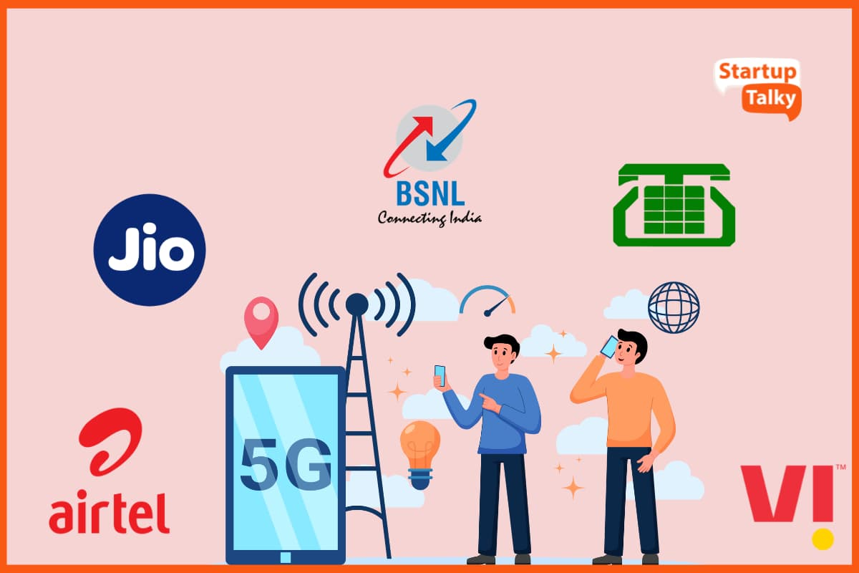
5G frequency bands in India:
There are many frequency bands available in India. The spectrum bid auctioned these bands. The bands available are: 700 MHz, 800 MHz, 900 MHz, 1800 MHz, 2100 MHz, 2500 MHz, 3300 MHz, and 26 GHz. All these bands have different offerings depending on internet speed and range.
These companies are regulated by Department of Telecommunications and TRAI under Ministry of Communications, Government of India.
Reliance Jio.
Airtel.
Vi.
Bharat Sanchar Nigam Limited (BSNL)
Mahanagar Telephone Nigam Limited (MTNL)

Slide 3
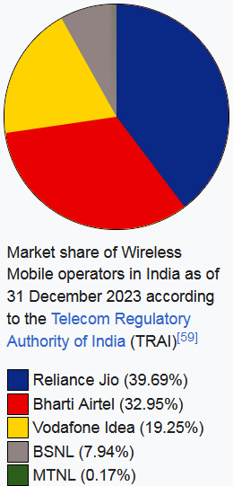
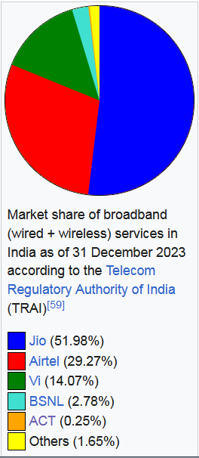

Slide 4
June 2024, India conducted a spectrum auction that concluded on June 26, 2024, after seven rounds of bidding. The auction was relatively subdued, with telecom companies bidding for 141.4 MHz of spectrum out of the 533.6 MHz available, amounting to approximately 26.5% of the offered spectrum. Press Information Bureau
The total revenue generated was ₹113.4 billion ($1.35 billion), significantly lower than the base price. 5G Training and 5G Certification
Bharti Airtel emerged as the leading bidder, acquiring 97 MHz of spectrum for ₹68.57 billion ($820.8 million). This purchase included both expiring and additional spectrum to bolster its 5G mid-band holdings.
Reliance Jio Infocomm secured spectrum worth ₹9.74 billion, while Vodafone Idea acquired spectrum valued at ₹3.51 billion. Notably, there was no bidding activity in the 800 MHz, 2300 MHz, 3300 MHz, and 26 GHz bands.

Slide 5
What is 5G?
The forthcoming International Mobile Telecommunications (IMT)-2020 requirements of ITU-R (radio section of the International Telecommunications Union).
5G provides much faster data rates with very low latency compared to the current systems up to 4G. It thus facilitates the adaptation of highly advanced services in wireless environment.
The industry seems to agree that 5G is, in fact, a combination of novel (yet to be developed and standardized) solutions and existing systems basing on 4G Long-Term Evolution (LTE)-Advanced, as well as non-3GPP access technologies such as Wi-Fi, which jointly contributes to optimizing the performance (providing at least 10 times higher data rate compared to current LTE-Advanced networks), lower latency (including single-digit range in terms of millisecond), and support of increased capacity demands for huge amounts of simultaneously connected consumer and machine-to-machine, or M2M, devices.
The ongoing work on the development of the next big step in the mobile communications, the fifth generation, includes the IoT as an integral part. Although one of the key goals of the 5G is to provide considerably higher data rates compared to the current 4G systems, with close to zero delays, at least an equally important aspect of the new system will be the ability to manage huge amount of simultaneously communicating IoT devices – perhaps thousands under a single radio cell.

Slide 6
Research
There are also several research programs established to study the feasibility and performance of new ideas in academic level. As an example, the European Union (EU) coordinates 5G research programs under various teams.
More information about the latest European Commission (EC) funded 5G research plan can be found in EU web page, which summarizes 5G initiatives [6]. As stated by EU, the 5G of telecommunications systems will be the most critical building block of our digital society in 2020–2030
EU states that 5G will provide virtually ubiquitous, ultra-high bandwidth connectivity not only to individual users but also to connected objects. Therefore, it is expected that the future 5G infrastructure will serve a wide range of applications and sectors, including professional uses such as assisted driving, eHealth, energy management, and possibly safety applications.
As for the 5G radio capacity needs on the current bands, the European Commission aims to coordinate the use of the 700 MHz band for mobile services to provide higher-speed and higher-quality broadband and cover wider areas, including rural and remote regions. The concrete goal of EU is to provide mobile broadband speeds beyond 100 Mb/s

Slide 7
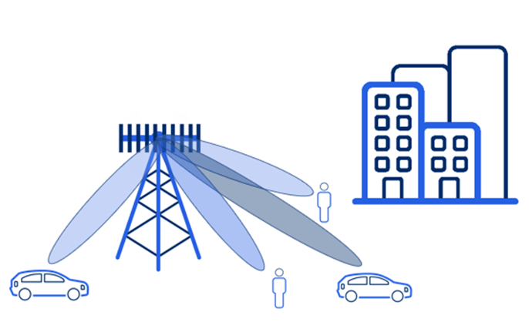
Challenges for Electronics?
One of the expected key abilities of the 5G networks is the high-energy efficiency to cope with a big amount of low-power IoT devices in the field. The benefits include better cost-efficiency, sustainability, and widening the network coverage to remote areas.
Some of the base technologies for facilitating the low energy include advanced beamforming as well as radio interface optimization via user-data and system-control plane separation.
The systems also need to be developed at the component level for both networks and devices. Autonomously functioning remote IoT devices require special attention, as they must function reliably typically several years without human interaction or maintenance.
The advances in the more efficient battery technologies are thus in key position.
At the same time, the need for enhanced security aspects will require innovative solutions in the hardware (HW) and software (SW) levels

Slide 8
Expected 5G in Practice
The Telecom industry has identified a further need for considerably faster end-user data rates to cope with the demands of the evolving multimedia.
The 5G could handle these challenging capacity requirements to provide fluent user experiences even for the most advanced virtual reality applications. At the same time, the exponentially growing number of the IoT devices require new security measures, including potential security-breach monitoring and prevention.
The 5G systems will be reality soon. During the deployment and operation of 5G networks, we can expect to see many novelty solutions such as highly integrated wearable devices, household appliances, industry solutions, robotics, self-driving cars, virtual reality, and other advanced, always-on technologies that benefit greatly from enabling 5G platforms.
One of the major needs is to ensure the proper security of the new 5G services and infrastructure, including protection of identity and privacy.
Advanced 5G system is the clearly better flexibility compared to any of the previous mobile communication generations. This refers to the optimal network resource utilization and providing new business models for variety of new stakeholders. This means that the 5G network functionality will be highly modular, which acilitates cost-efficient, on-demand scalability.

Slide 9
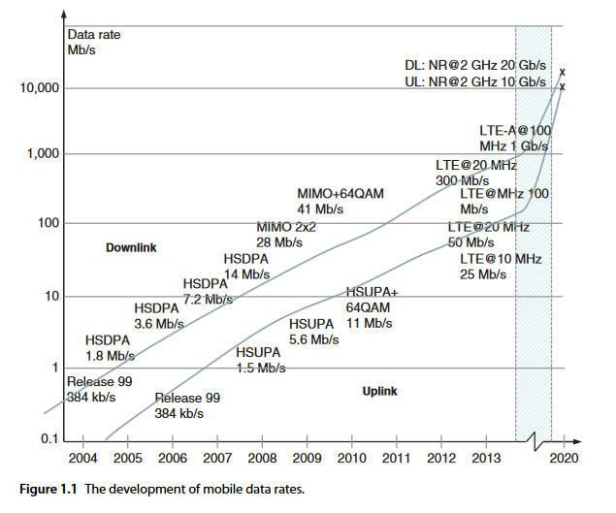

Slide 10
Motivations
One might wonder why yet another mobile communications generation is really needed.
In fact, the fourth generation already provides quite impressive performance with low
latency and high data rates.
The reasons are many-folded. Not only the increasing utilization of the mobile
communications networks for ever-advancing applications including higher-definition
video, virtual reality, and artificial intelligence require much more capacity even in
remote areas, but – and one might argue if even primarily – the need is derived from
the exponential increase of the IoT devices. The number of the intelligent sensors and
other machines communicating with each other, service back-ends require support for
much more simultaneously connected devices. The amount may be, as stated in one
of the core requirements of the ITU, one million devices per km2 , which outnumbers
clearly even the theoretically achievable capacity the advanced 4G can offer. The 5G
would thus benefit especially massive IoT development, the increased data rates for
consumers being another positive outcome of the new technology.

Slide 11
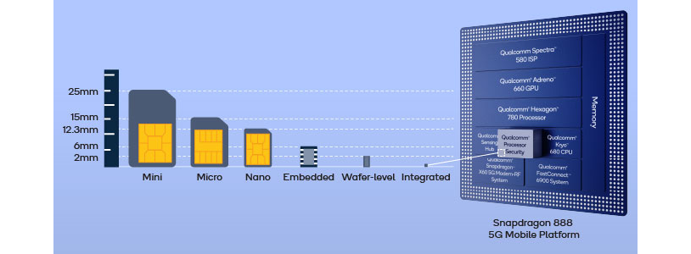
5G and Security
A SIM (Subscriber Identity Module) is a small chip within a mobile device that stores a user's unique identification information, allowing them to access a cellular network, while a UICC (Universal Integrated Circuit Card) is the physical hardware that houses the SIM application, essentially acting as the platform on which the SIM functions; different "subscription types" refer to the various service plans a user can choose with their SIM, like prepaid, postpaid, or data-only plans depending on their usage needs.

Slide 12
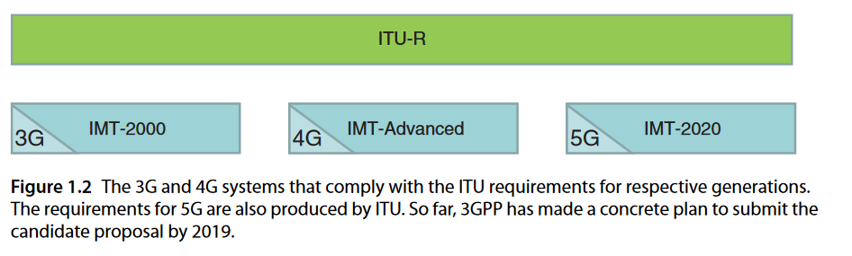
5G Standardization and Regulation
International Telecommunication Union Radiocommunication Sector (ITU-R)
What does ITU-R do?
ITU-R regulates the radio-frequency spectrum and satellite orbits
It sets standards for radio communication systems, including spectrum management
It helps manage the limited natural resources of the radio-frequency spectrum and satellite orbits
What is the importance of ITU-R?
The radio-frequency spectrum is an essential resource for wireless technologies
The allocation of the radio-frequency spectrum determines which operators can provide internet services to communities

Slide 13
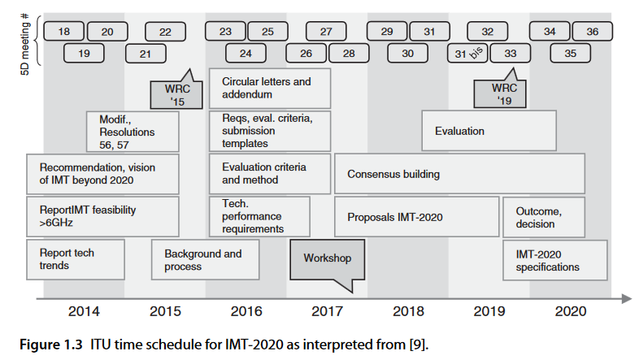
The IMT-2020 is in practice a program to describe the 5G as a next-evolution step after the IMT-2000 and IMT-Advanced, and it also sets the stage for the international 5G research activities.
The aim of the ITU-R is to finalize the vision of 5G mobile broadband society.
The timeline of ITU is the following
2016–2017. Performance requirements, evaluation criteria, and assessment methodology of new radio;
2018. Time frame for proposal;
2018–2020. Definition of the new radio interfaces;
2020. Process completed.

Slide 14

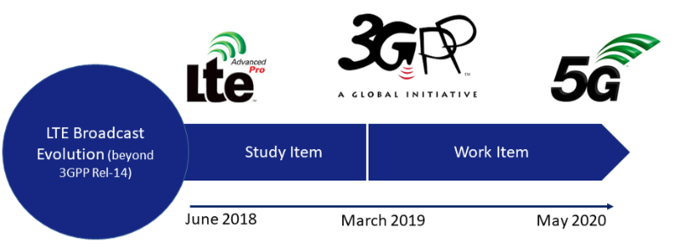
3GPP (Third Generation Partnership Project)
ITU-R is preparing for the evaluation of the 5G candidate technologies that would be compatible with the 5G framework as seen by ITU, one of the active standardization bodies driving the practical 5G solutions is the 3GPP, which is committed to submitting a candidate technology to the IMT-2020 process. The 3GPP is aiming to send the initial technical proposal to the ITU-R.
As for the 3GPP specifications, 5G will affect several technology areas of radio and core networks. The expected aim is to increase the theoretical 4G data rates perhaps 10–50 times higher whilst the response time of the data would be reduced drastically, close to zero.

Slide 15
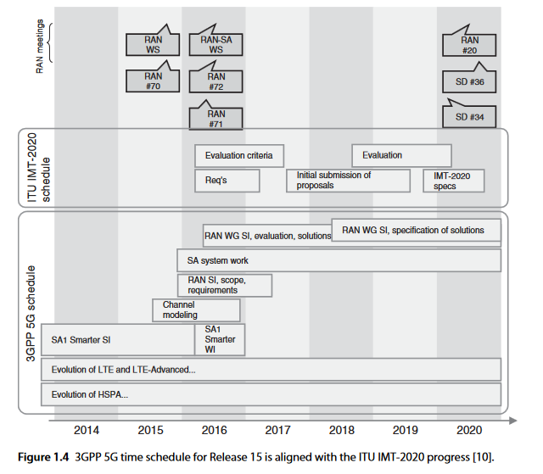
3GPP is committed to submitting a candidate technology to the IMT 2020 process based on the following time schedule, as described in the reference SP-150149 (5G time-
line in 3GPP)
The second phase of 5G as defined by 3GPP Release 16 with full functionality can be expected to be reality a few months after the freezing of the Release 16
These networks can support also the rest of the 5G pillars in addition to the eMBB, i.e. massive Internet of Things (mIoT) and critical communications referred to as ultrareliable low latency communications (URLLC).

Slide 16
Global Standardization in 5G Era
GlobalPlatform
ITU
IETF- The Internet Engineering Task Force
3GPP/3GPP2
ETSI-The European Telecommunications Standards Institute
IEEE-The Institute of Electrical and Electronics Engineers
SIMalliance
Smart Card Alliance
GSMA - The GSM Association NIST - The US National Institute of Standards Technology
NHTSA - The National Highway Transportation and Safety Administration
ISO/IEC- The International Organization for Standardization (ISO)/International Electrotechnical Commission
ISO/IEC JTC- Joint Technical Committee
OMA- Open Mobile Alliance (OMA)

Slide 17
Global Standardization in 5G Era
CEPT/ECC - Conférence Européenne des Postes et des Télécommunications (CEPT) and Electronic Communications Committee
NERC- North American Electric Reliability Corporation
OWASP
Open Web Application Security Project (OWASP)
OneM2M
Global Standards Collaboration
CSA - Cloud Security Alliance
NGMN- Next Generation Mobile Networks
Car-to-Car Communication Consortium
5GAA - 5G Automotive Association
Trusted Computing Group
InterDigital

Slide 18
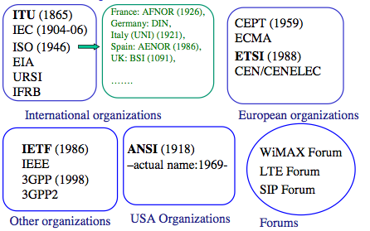

Slide 19
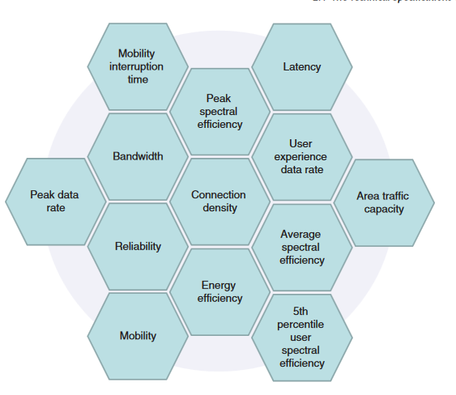
5G Requirements Based on ITU

Slide 20
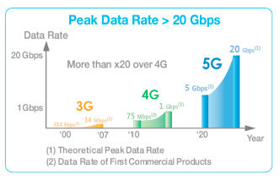
Peak Data Rate
The peak data rate (b/s) refers to the maximum possible data rate
minimum downlink peak data
rate is 20 Gb/s whereas the value for uplink is 10 Gb/s.

Slide 21
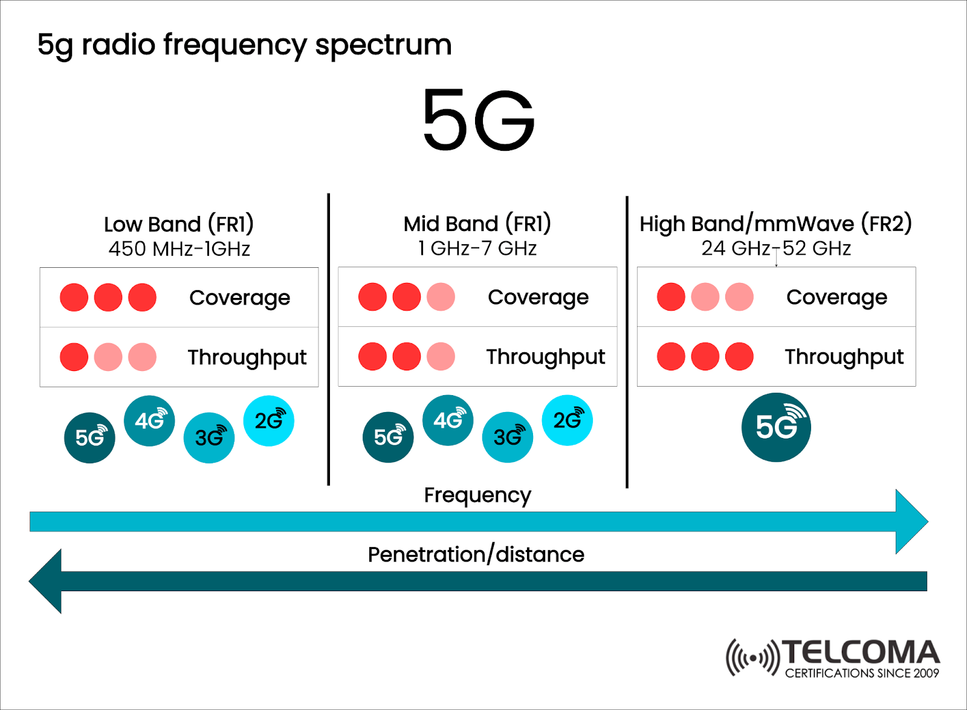
Peak Spectral Efficiency
The peak spectral efficiency for the downlink is set to 30 b/s/Hz, whereas the value for the uplink
is 15 b/s/Hz

Slide 22
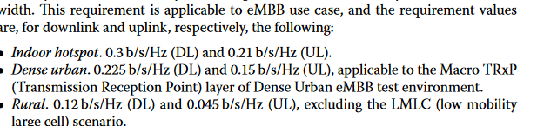
User Experienced Data Rate
The ITU requirements for the UX data rate in downlink is 100 Mb/s, whereas it is 50 Mb/s for uplink.
Fifth Percentile User Spectral Efficiency

Slide 23

Average Spectral Efficiency
Spectrum efficiency describes the amount of data transmitted over a given spectrum or bandwidthwith minimum transmission errors.
Area Traffic Capacity
The area traffic capacity refers to the total traffic throughput within a certain geographic area, and is expressed in Mb/s/m2 .
The target value for the area traffic capacity is set to 10 Mb/s/m 2 .

Slide 24
Connection Density
Connection density refers to the total number of 5G devices that can still comply with the target QoS (quality of service) level within a geographical area which is set to 1 km2
The minimum requirement for the connection density is set to 1 000 000 devices per km 2 .
Energy Efficiency
Energy efficiency simply means using less energy to perform the same task.
The high-level definition of the 5G energy efficiency indicates the capability of the radio interface technology (RIT) and set of RITs (SRIT) to minimize the radio access net- work (RAN) energy consumption for the provided area traffic capacity.

Slide 25
Reliability
The reliability of 5G in general refers to the ability of the system to deliver the desired amount of packet data on layers 2 and 3 within expected time window with high success probability, which is dictated by a channel quality. This requirement is applicable to the URLLC use cases
Mobility
The 5G mobility requirement refers to the maximum mobile station speed in such a way that the minimum QoS requirement is still fulfilled. There is a total of four mobility classes defined in 5G:
stationary with 0 km/h speed;
pedestrian with 0–10 km/h;
Vehicular with 10–120 km/h;
high-speed vehicular with speeds of 120–500 km/h

Slide 26
Bandwidth
The bandwidth in 5G refers to the maximum aggregated system bandwidth and can consist of one or more radio frequency (RF) carriers.
The minimum supported bandwidth requirement is set to 100 MHz, and the RIT/SRIT shall support bandwidths up to 1 GHz for high-frequency bands such as 6 GHz. Furthermore, the ray tracing (RT)/SRIT shall support scalable bandwidth

Slide 27
The Technical Specifications of 3GPP
In the path toward 3GPP Release area 15, which is the first set of technical specifications defining 5G, the 3GPP has studied plenty of items to comply with the high-level 5G requirements of the ITU-R. The items are related to the enhancement of the LTE, as well as the completely new topics related to 5G.
1. Uplink data compression (UDC) : This is a feature that would be implemented between evolved NodeB (eNB) and UE.
2. Enhanced LTE bandwidth flexibility. This item aims to further optimize the spectral efficiency within the bandwidths of 1.4–20 MHz.
3. Enhanced Voice over Long-Term Evolution ( VoLTE) performance.
4. Virtual reality.
5. NR-based access to unlicensed spectrum.
6. NR support on nonterrestrial networks.
7. Enablers for network automation for 5G.
8. System and functional aspects of energy efficiency in 5G networks.

Slide 28
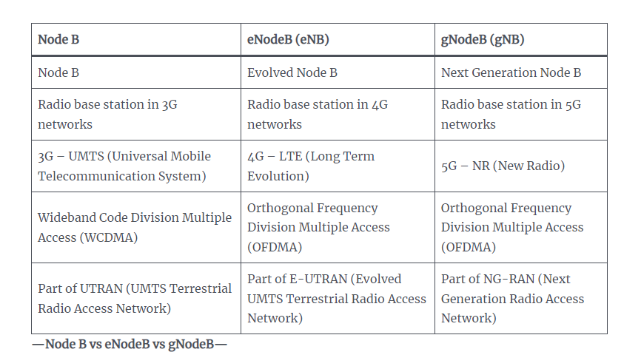

Slide 29
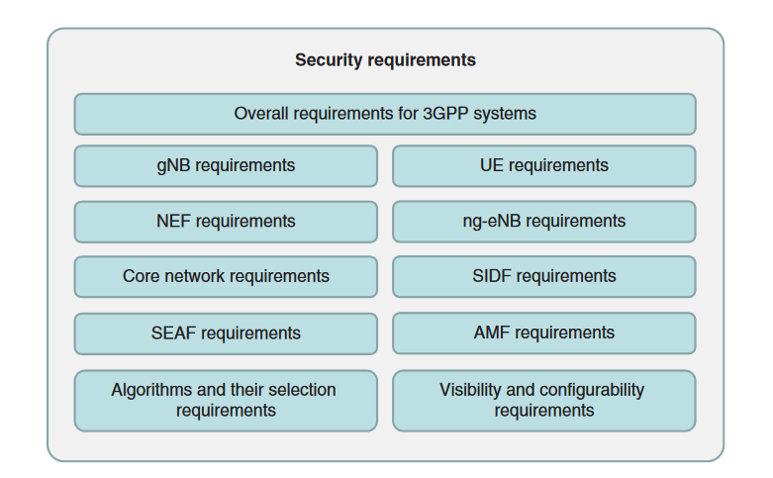
Security Requirements for 5G
Overall Security Requirements
The generic security requirements of the 3GPP TS 33.501 cover the following cases:
• UE must include protection against bidding-down attack.
• Network must support the subscription authentication and key agreement (AKA).

Slide 30
The 5G UE requirements as interpreted from 3GPP TS 33.501
1. Ciphering and integrity protection - User data and signalling data confidentiality
2. User data and signaling data integrity
3. Secure storage and processing of subscription credentials
4. Subscriber privacy
Key requirements for 5gNB.
1. User data and signaling data confidentiality
2. User data and signaling data integrity
3. gNB setup and configuration
4. gNB keymanagement
5. Handling of user and control data for the gNB

Slide 31
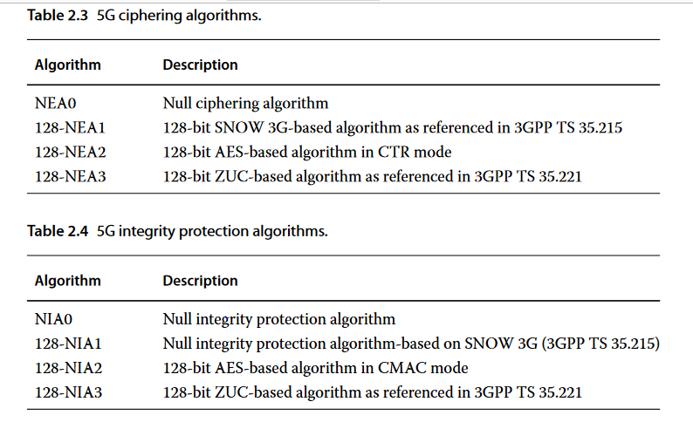
5G Algorithms

Slide 32
